Slide 1
DAY 1
Everything In Flutter Is A Widget
Flutter Training by DICT

Slide 2
Flutter Training by DICT

Slide 3
Objectives
To equip developers with the skills to design and build Flutter apps

Slide 4
Duration
5 days face to face training

Slide 5
Team
Trainer Aljon Mutalib

Slide 6
The Flutter Roadmap 🚩
Learn Flutter
Build Your Apps
Deploy Your Apps

Slide 7
The Flutter Roadmap 🚩
Build a portfolio of Flutter apps

Slide 8
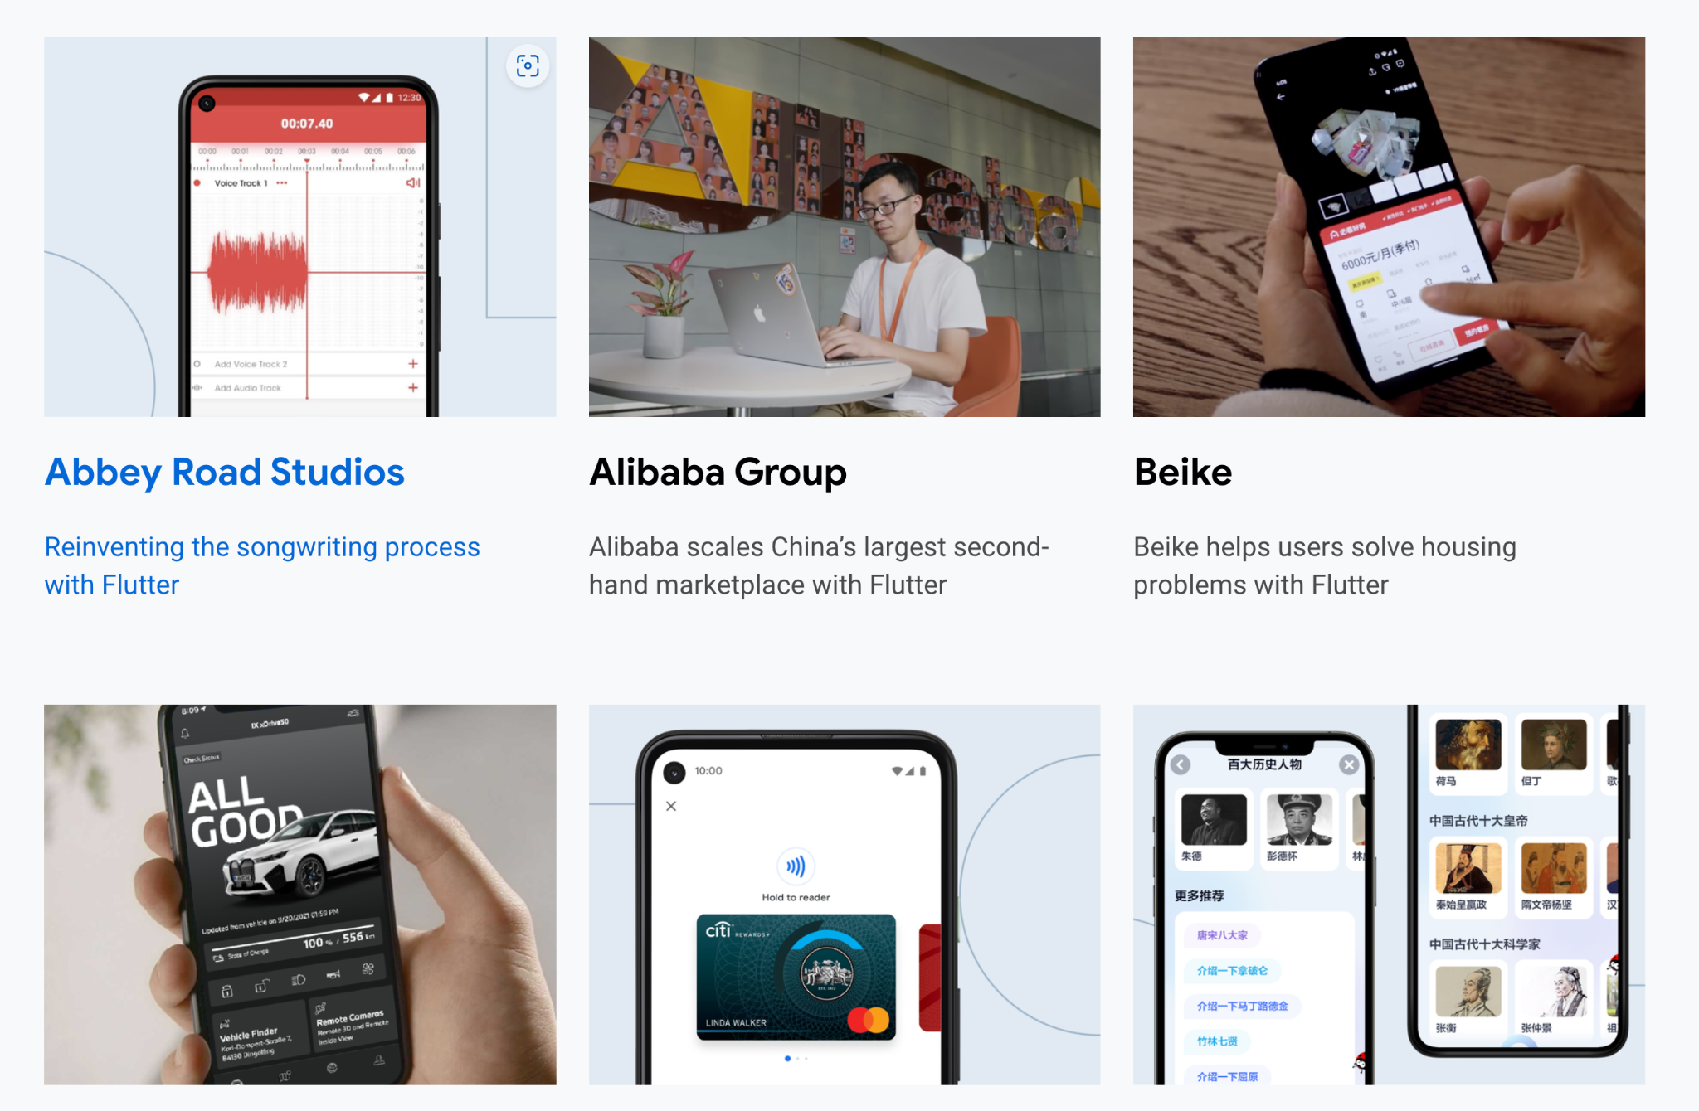

Slide 9
Camper Onboarding
Google Classroom
Make you to coordinate with the DICT leads and organizers

Slide 10
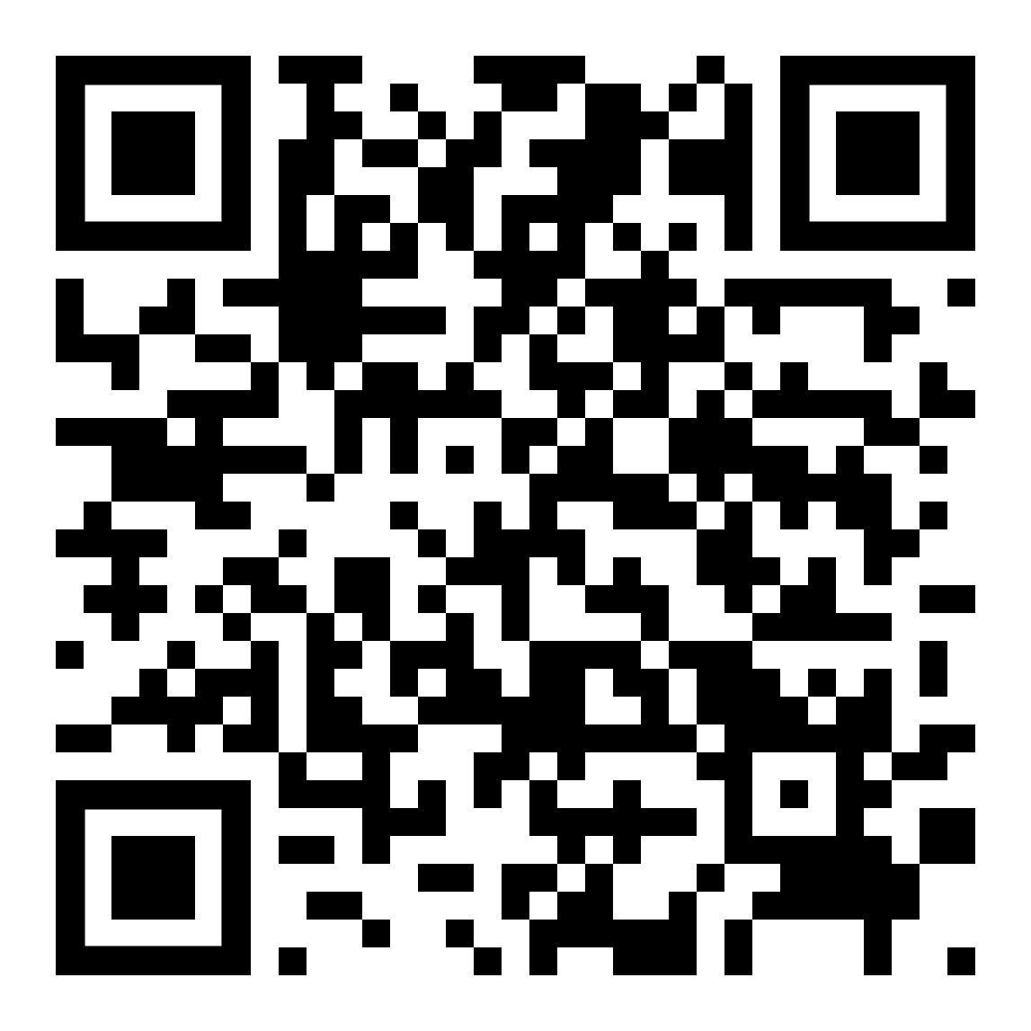
Camper Onboarding
Flutter Zamboanga
Ask questions. Collaborate. Build.

Slide 11
Camper Onboarding
Github
Create your Github account by visiting github.com. Then, create a repo called flutter-bootcamp. Last, set it to private.

Slide 12
Before We Learn Flutter

Slide 13
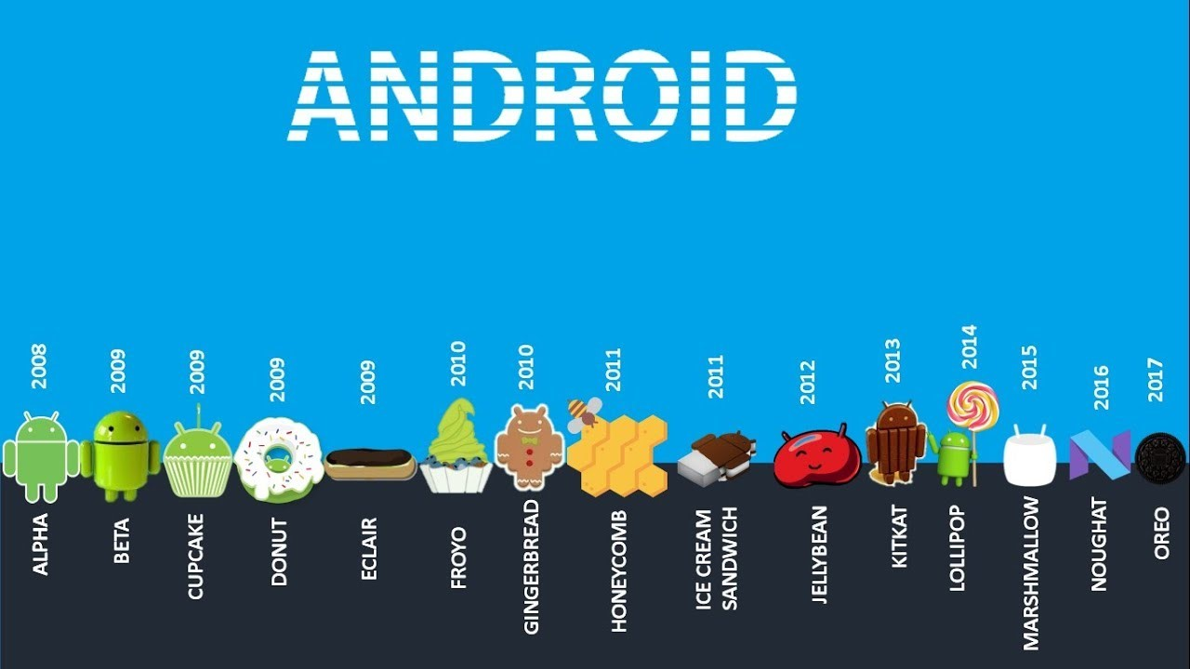

Slide 14
Native Android Development
Uses Kotlin & Java
Compiles in native machine code for devices like phones, TV, and desktop computers

Slide 15


Slide 16
Native iOS Development
Uses Swift & Obj-C
Compiles in native machine code for devices like iPhone and iPads

Slide 17
Beyond Flutter
The web, native device architectures, app stores, deployment, etc.

Slide 18
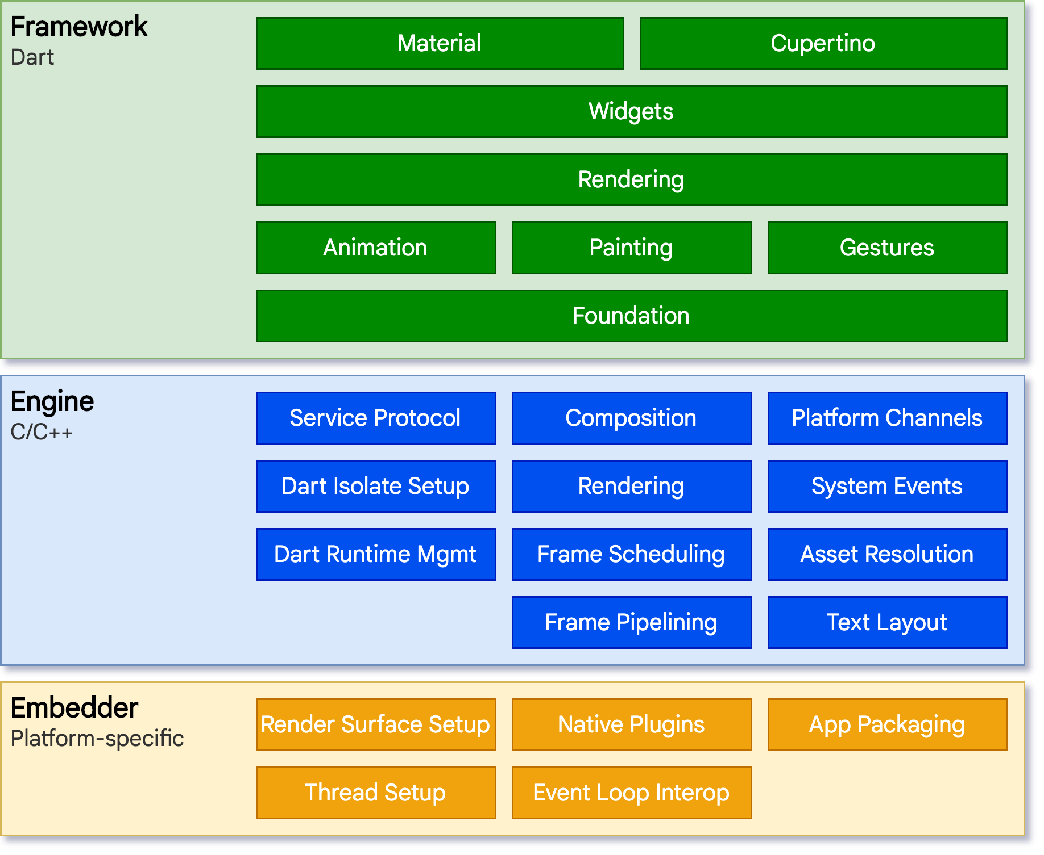

Slide 19
Everything Is A Widget In Flutter

Slide 20
Everything Is A Widget In Flutter
Flutter is a UI toolkit used for building apps for mobile, web and desktop applications

Slide 21
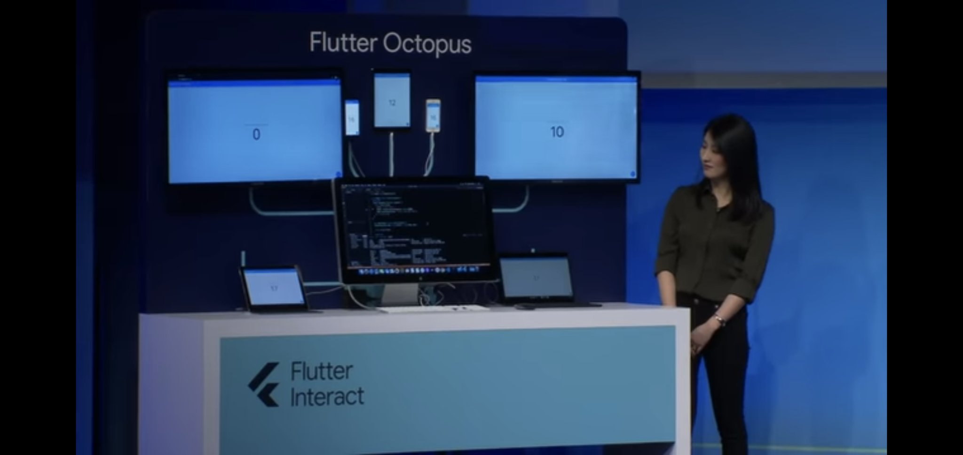

Slide 22
Flutter Features
Fast, Productive, and Flexible

Slide 23
Flutter Everywhere
Flutter 3 and beyond 500K+ apps deployed everywhere Flutter 2 125K+ apps in the Google Play Store
Notes:
Companies Using Flutter in 2022 (nomtek.com)

Slide 24
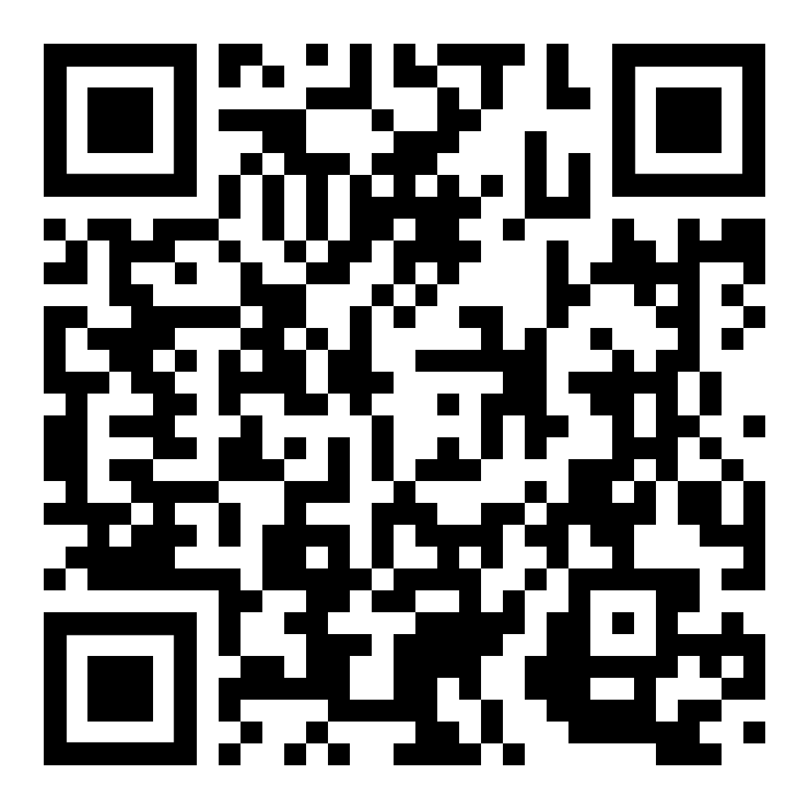
Flutter Philippines
5000+ members combined everywhere 300+ members in our Facebook Group
Notes:
Companies Using Flutter in 2022 (nomtek.com)

Slide 25
Flutter Features
Flutter uses Dart
Flutter is declarative
Pre-built Flutter packages published on pub.dev

Slide 26
Flutter Basic Commands
flutter create
flutter pub get
flutter run

Slide 27
Activity 1 Simple Stock UI Clone

Slide 28
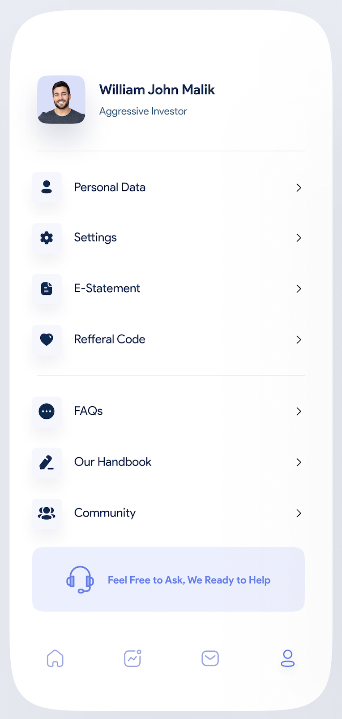
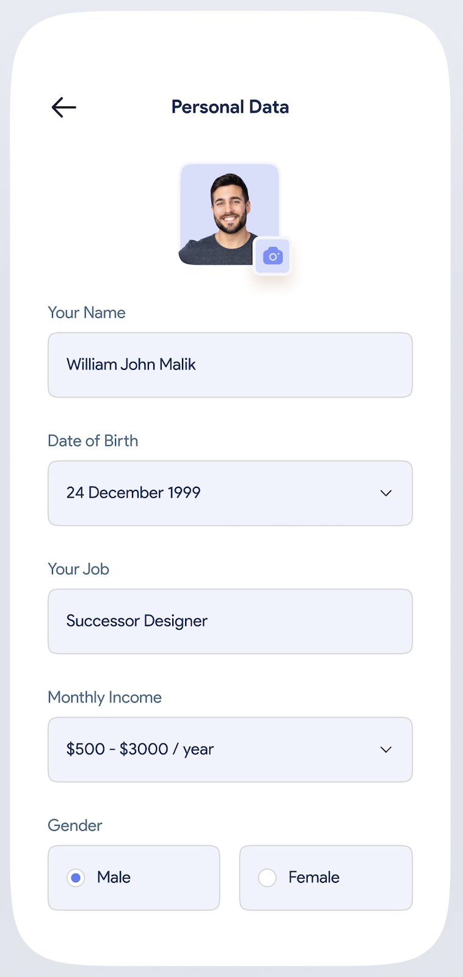
Activity 1 - Simple Stock UI Clone

Slide 29
Quizzz Everything in Flutter is a Widget

Slide 30
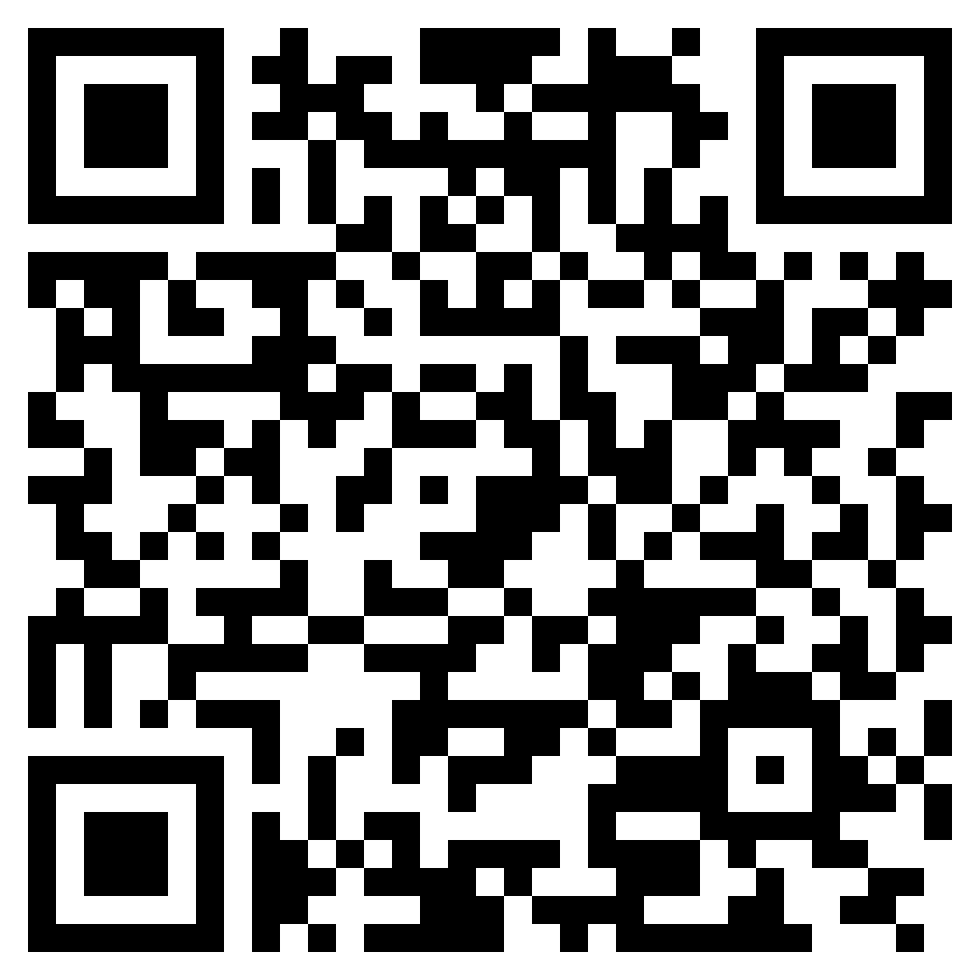
Quiz for 100 pts

Slide 31
Activity 2 Complete Simple Stock UI Clone

Slide 32
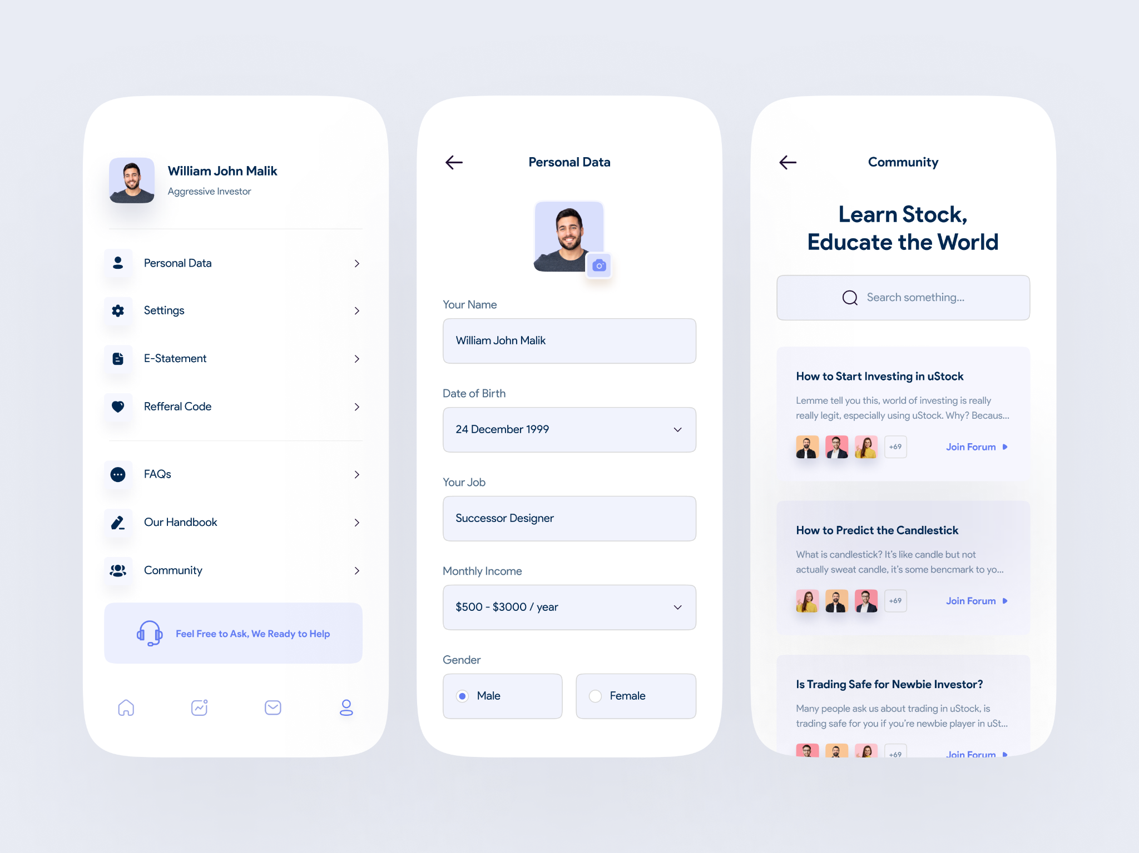
Activity 2 - Complete Simple Stock UI Clone

Slide 33
Thank you! Make sure to get some rest!

